Slide 1
What is a virtual machine?
A Virtual Machine (VM) is a compute resource that uses software instead of a physical computer to run programs and deploy apps. One or more virtual “guest” machines run on a physical “host” machine. Each virtual machine runs its own operating system and functions separately from the other VMs, even when they are all running on the same host. This means that, for example, a virtual MacOS virtual machine can run on a physical PC.
Virtual machine technology is used for many use cases across on-premises and cloud environments. More recently, public cloud services are using virtual machines to provide virtual application resources to multiple users at once, for even more cost efficient and flexible compute.

Slide 2
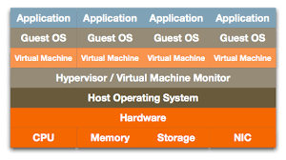

Slide 3
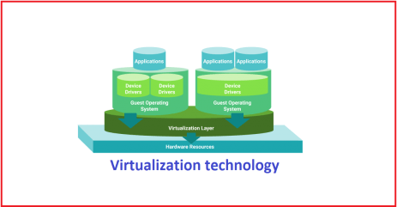

Slide 4
How do virtual machines work? The virtual machine runs as a process in an application window, similar to any other application, on the operating system of the physical machine. Key files that make up a virtual machine include a log file, NVRAM setting file, virtual disk file and configuration file.

Slide 5
Advantages of virtual machines
Virtual machines are easy to manage and maintain, and they offer several advantages over physical machines:
VMs can run multiple operating system environments on a single physical computer, saving physical space, time and management costs. Virtual machines support legacy applications, reducing the cost of migrating to a new operating system. VMs can also provide integrated disaster recovery and application provisioning options.

Slide 6
Disadvantages of virtual machines
While virtual machines have several advantages over physical machines, there are also some potential disadvantages:
Running multiple virtual machines on one physical machine can result in unstable performance if infrastructure requirements are not met.
Virtual machines are less efficient and run slower than a full physical computer. Most enterprises use a combination of physical and virtual infrastructure to balance the corresponding advantages and disadvantages.

Slide 7
The two types of virtual machines
Users can choose from two different types of virtual machines—process VMs and system VMs:
A process virtual machine allows a single process to run as an application on a host machine, providing a platform-independent programming environment by masking the information of the underlying hardware or operating system. An example of a process VM is the Java Virtual Machine, which enables any operating system to run Java applications as if they were native to that system.
A system virtual machine is fully virtualized to substitute for a physical machine. A system platform supports the sharing of a host computer’s physical resources between multiple virtual machines, each running its own copy of the operating system. This virtualization process relies on a hypervisor, which can run on bare hardware, such as VMware ESXi, or on top of an operating system.

Slide 8
What are 5 types of virtualization?
Hardware virtualization: When virtualizing hardware, virtual versions of computers and operating systems (VMs) are created and consolidated into a single, primary, physical server.
A hypervisor communicates directly with a physical server’s disk space and CPU to manage the VMs. Hardware virtualization, which is also known as server virtualization, allows hardware resources to be utilized more efficiently and for one machine to simultaneously run different operating systems.

Slide 9
What are 5 types of virtualization?
Software virtualization: Software virtualization creates a computer system complete with hardware that allows one or more guest operating systems to run on a physical host machine.
For example, Android OS can run on a host machine that is natively using a Microsoft Windows OS, utilizing the same hardware as the host machine does.
Additionally, applications can be virtualized and delivered from a server to an end user’s device, such as a laptop or smartphone. This allows employees to access centrally hosted applications when working remotely

Slide 10
What are 5 types of virtualization?
Storage virtualization: Storage can be virtualized by consolidating multiple physical storage devices to appear as a single storage device. Benefits include increased performance and speed, load balancing and reduced costs.
Storage virtualization also helps with disaster recovery planning, as virtual storage data can be duplicated and quickly transferred to another location, reducing downtime.

Slide 11
What are 5 types of virtualization?
Network virtualization: Multiple sub-networks can be created on the same physical network by combining equipment into a single, software-based virtual network resource. Network virtualization also divides available bandwidth into multiple, independent channels, each of which can be assigned to servers and devices in real time.
Advantages include increased reliability, network speed, security and better monitoring of data usage. Network virtualization can be a good choice for companies with a high volume of users who need access at all times.

Slide 12
What are 5 types of virtualization?
Desktop virtualization: This common type of virtualization separates the desktop environment from the physical device and stores a desktop on a remote server, allowing users to access their desktops from anywhere on any device.
In addition to easy accessibility, benefits of virtual desktops include better data security, cost savings on software licenses and updates, and ease of management.

Slide 13
What Is a Hypervisor?
A hypervisor is hardware, software, or firmware capable of creating virtual machines and then managing and allocating resources to them. Virtual machines are machines set up to use the resources of the host machine.
You can divide these resources as many times as you like to accommodate the necessary virtual machine “guests.” (If you’ve heard the term “virtual machine monitor,” you may be curious about the difference between a virtual machine monitor and a hypervisor. They’re the same thing.)

Slide 14
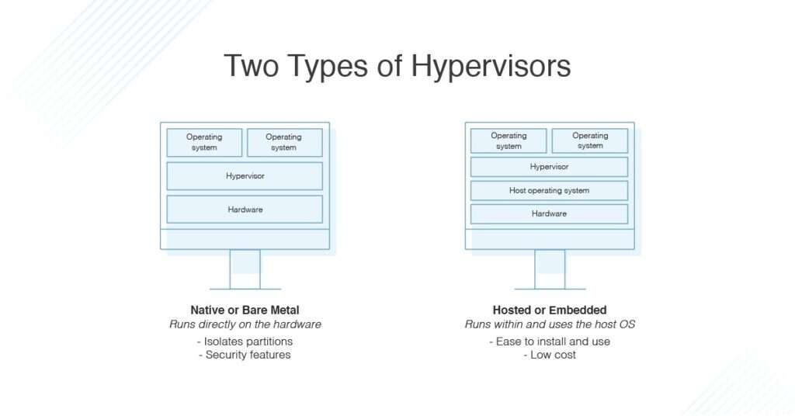
Types of Hypervisors

Slide 15
Bare Metal Hypervisor
A bare metal hypervisor is installed directly on the hardware of your machine, whereas a hosted hypervisor is installed on your operating system. Bare metal hypervisors are typically faster and more efficient because they have direct access to the underlying hardware and don’t need to go through the operating system layer. Since they don’t have to compete with other applications or the OS, they can take all the available physical hardware power and allocate it to virtual machines. They also tend to be more secure, because, without an operating system on the host, less attack surface is available for malicious intruders.

Slide 16
Hosted Hypervisor
However, hosted hypervisors are significantly easier to set up and get running, as you can use the more user-friendly operating system. They’re often used for testing and development purposes, as they can run on the OS to try out new programs or features without affecting the host OS.

